Slide 1

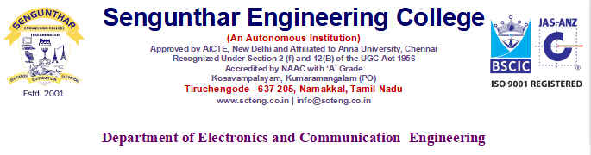


INTEGRATED VEHICLE SAFETY SYSTEM(IVSS)
19ECJ701 – PROJECT PHASE - 1
Batch member :
MOHAN. A (201914007)
PRASANTH. N (201914009)
Under the Guidance of
Dr.C.AARTHI, M.E.,Ph.D,
HOD/ECE
SEC
21-Oct-22

Slide 2
Content
Abstract
Introduction
Existing System
Proposed System
Literature Survey
21-Oct-22

Slide 3
Abstract
Travelling is important and necessity for human life and now-a days it is turned to be as dangerous due to more number of road accidents.
The IVSS monitors & controls the driver drowsiness, alcohol level, speed limit & CO2 emission.
The system will detect early symptoms of drowsiness and alcohol content before the driver has fully lost attentiveness and warn the driver and automatically stop the vehicle.
Hence the system reduce the quantum of road accidents.
21-Oct-22

Slide 4
Introduction
India had earned the dubious destination of having more number of fatalities due to road accidents. Road safety is emerging and a major social concern around the world especially in India.
Drinking and Driving and Driver drowsiness, Vehicle carbon emission is already a serious public health problem, which is likely to emerge as one of the most significant problem in near future.
The system implemented by us aims to reduce the road accidents in the near future due to drunken driving and driver drowsiness.
21-Oct-22

Slide 5
Existing System
Automatic vehicle accident detection and messaging system uses accelerometer in Cr alarm application.
The accident can be sensed by using the vibration sensor.
Using ARM controller the mobile number can be saved in EEPROM and sends the message when accident occurs.
The driver drowsiness was detected send alert the driver.
Alcohol level was detected and alert the passengers.
21-Oct-22

Slide 6
Proposed System
The proposed system is an Integrated system which integrate all the sensors into a single module.
In the existing system, some times the drive don’t consider the alert and drive continuously .The proposed system is establishing a technique to avoid the drawbacks of existing system.
The system will detect early symptoms of drowsiness and alcohol content before the driver has fully lost attentiveness and warn the driver and automatically stop the vehicle.
Then sensor are monitoring the carbon emission level and increase the carbon level automatically lock or stop the engine.
21-Oct-22

Slide 7
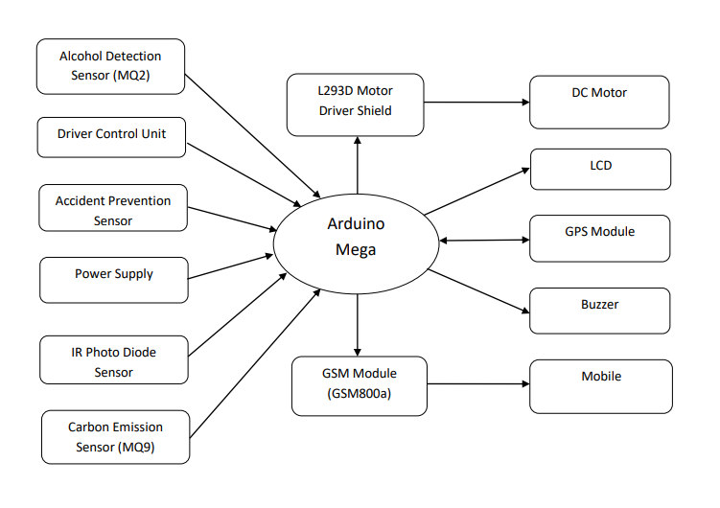
Block Diagram
21-Oct-22

Slide 8
Tools Used
Arduino Mega
GSM Module
Accelerometer sensor
Alcohol Sensor
IR Photo diode Sensor
Carbon Emission Sensor
L293D Motor Driver Shield
16X2 LCD Display
GPS Module
Buzzer
DC Motor
Board for making the components
Other components
21-Oct-22

Slide 9
Literature Survey
Title of the paper | Methodology | Publication details
In-Vehicle Sleeping Detection System | Some devices based upon measures of eye activity were considered to be suitable, depending on the way in which measures were taken, and those considered as potential candidate devices for further evaluation have been identified. | N A Wrigh January 2006 Report number: PPR 157,Transport Research Laboratory UK
Alcohol Detection System with Vehicle Tracking | If a driver is drunk and tries to drive the system detects alcohol presence in his/her breathe and locks the engine so that the vehicle fails to start | Vijay N. Kukre Vol-4 Issue-2 2018
21-Oct-22

Slide 10
IoT Based Vehicle Emission Monitoring and Alerting System | These methods are applicable to gather only the average air quality rather than identifying the individual polluting vehicles. | Arun Mozhi Devan Panneer Selvam, October 2019, 2019 IEEE Student Conference on Research and Development (SCOReD)
Design of Vehicle Accident Prevention System Using Wireless Technology | Driver drowsiness is a significant factor in vehicular accidents and therefore different technologies are being put in place to bring it to the barest minimum. | Stephen Eduke October 2017,
21-Oct-22

Slide 11


21-Oct-22

